Slide 1
Pears Community Spaces Fund

Slide 2
Connecting people who care to causes that matter

Slide 3
Our vision:
A peaceful, prosperous, shared and just society

Slide 4
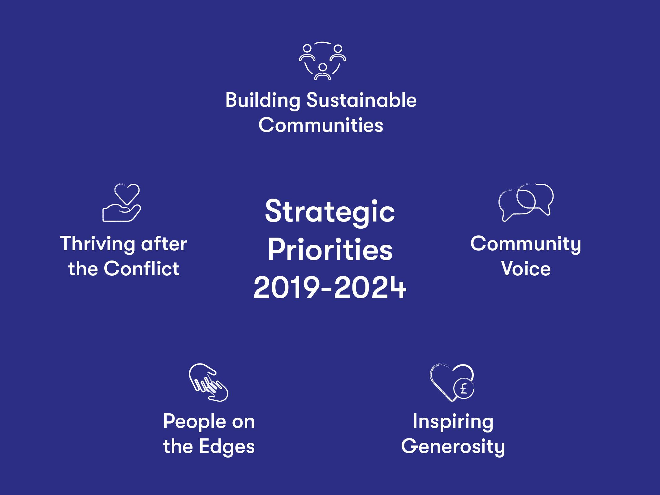

Slide 5
Pears Foundation
A transformative force, working for social justice through effective philanthropy.
Empowering a global community of organisations and individuals, providing leadership and resources to break down the barriers to progress.
Inspiring others to engage and multiplying the Pears impact by fostering the next generation of active citizens.
Creating spaces for passionate people to develop their ideas and apply their talents for the good of everyone

Slide 6
Pears Community
Spaces Fund
Community and voluntary groups working together to jointly evidence need and bid for funding.
Using a shared space in their local community or to carry out joint activities or events aimed at bringing different communities together, whether that be communities of faith, ethnicity, neighbourhood or of different backgrounds.
Giving groups and communities the space to connect, share ideas, explore and learn together.

Slide 7
Pears Community
Spaces Fund
By
Using a space in a shared way within the local community
Or to carry out joint activities or events aimed at bringing different communities together, whether that be communities of faith, ethnicity, neighbourhood or of different backgrounds.
Pears Foundation and Community Foundation wish to support projects that
Are developed through collaborative working and engagement through joint bidding for funding,
Demonstrate that community/voluntary organisations are working together
Foster respect and understanding between people of different backgrounds.
Give space to people/communities/groups to connect, share ideas, explore and learn together.

Slide 8
Pears Community
Spaces Fund
What outcomes do we expect
Increased contact and dialogue among project participants in NI and their community and those of another community background, faith or political persuasion, Indicated by the number of grantees who indicate a positive attitudinal change towards people from different backgrounds and the number of new relationships.
Underpinning the Peace Process and promoting community development and cohesion, indicated by the number of people participating in peace building and capacity building for the first time and the number of intra and inter community engagements/activities.
Increased understanding, tolerance and respect to and for each other on the post conflict legacy issues which divides us, indicated by the number of participants engaging in capacity building, including events and training, during the programme.

Slide 9
Pears Community
Spaces Fund
What outcomes can we expect (continued)
4. Increased sharing & use of space between and within for community cohesion and community development related activities Has the project led to meaningful contact between communities; has it led to increased levels of cohesion and trust and engagement in the community; has it led to increased engagement by disaffected young people in community life?
5. Increased dialogue among the sector and other stakeholders to address key and or emerging themes which could destabilize community cohesion.
6. Increased contact and dialogue between policy makers and the community voluntary
sector.

Slide 10
Pears Community
Spaces Fund
Funding Available For This Phase of Applications
£39,000(Max award size £5k)

Slide 11
Pears Community Spaces Fund
Programme Criteria:
All projects must give space to groups to connect, share ideas, explore and learn together.
All projects must be developed and delivered through a partnership approach

Slide 12
Pears Community Spaces Fund
Programme Criteria Continued
In addition projects must meet one or more or the following;
1. Increased contact and dialogue among project participants in NI and their community and those of another community background, faith or political persuasion
2. Underpinning the Peace Process and promoting community development and cohesion
3. Increased understanding, tolerance and respect to and for each other on the post conflict legacy issues which divides us
4. Increased sharing & use of space between and within for community cohesion and community development related activities
5. Increased dialogue among the sector and other stakeholders to address key and or emerging themes which could destabilize community cohesion.
6. Increased contact and dialogue between policy makers and the community voluntary sector.

Slide 13
Pears Community Spaces Fund
Eligibility Criteria Check
Must Be Constituted Community/Voluntary Organisations (registered charity)
Please note that if any of the group’s objectives includes advancement of religion then group is not eligible for a grant award
Annual Income less than £250,000
Application to be accompanied by:
Governing document
Recent annual accounts or income and expenditure
Child safeguarding policy (if applicable to project)
Adults safeguarding policy (if applicable to project)
Equality policy
If any of the above are missing when application is submitted, application will not proceed to assessment.

Slide 14
Pears Community Spaces Fund
How to Apply?
Via Community Foundation Website: www.communityfoundationni.org
Grant Must Be Spent within 18 months from date of Grant Aid Agreement
Monitoring Form To Be Returned Within 8 weeks of Project End and accompanied With Annual Accounts
Please note that you can’t have two live grants for the same programme

Slide 15
Pears Community Spaces Fund
Timeline
Year One - Phase 2
Applications open 10.00am Monday 4th November 2019
Applications close 1.00pm Thursday 12th December 2019
Applications assessed January - February 2020
Grant Panel meetings March 2020
Decisions announced at an award event week commencing Monday 30th March 2020

Slide 16
Requests for Queries and Clarifications to be emailed to mhughes@communityfoundationni.org

